Slide 1
The Linux File System

Slide 2
Introduction
“File System” is a group of files and relevant information regarding them.
The disk space alloted to a Linux File System is made up of 'blocks', each of which are of 512bytes
To find out block size on your file system, use the cmchk command
All the blocks belonging to the file system are logically divided into:
“Boot Block”
“Super Block”
“Inode Table”
“Data Blocks”

Slide 3

The Boot Block
Represents the beginning of the file system
Contains a program “bootstrap loader”
This program is executed when we 'boot' the host machine
All file system contain one (possibly empty) boot block

Slide 4
The Super Block
Describes the state of the file system
State – how large it is, how many maximum files it can accommodate, how many more files can be created, etc.

Slide 5
The Inode Table
The information related to all the files (not the contents) is stored in an Inode Table on the disk
For each file, there is an inode entry in the table
Each entry is made up of 64 bytes & contains the details for that file
These Details are:
Owner of the file
Group to which the owner belongs
Type of file
File Access Permission
Date and Time of last access
Date and Time of last modifications
Number of links to the file
Size of the file
Addresses of blocks where the file is physically present

Slide 6

Data Blocks
Conatins the actual file contents
An allocated block can belong to only one file in the file system
This block can't be used for storing any other file's contents unless the file to which it originally belonged is deleted

Slide 7
NOTE:
Information stored in the Inode Table must change whenever we use any file , or change its permissions, etc => Would gobble up a lot of precious CPU time
To remedy this, a copy of the Super Block and Inode Table gets loaded into RAM at start-up time
'sync' command synchronises the inode table in memory with the one on disk by simply overwriting the memory copy on to the disk

Slide 8
How does LINUX access files?
Suppose file 'reports' is present in 'mydir' directory and we attempt to cat the 'reports' file:
Check whether mydir have read permission
Find out whether this directory file has an entry reports in it
Pick up the inode number for reports from mydir
This inode number is an index into the in-core (memory) inode table
Using this inode number, information about reports can be accessed from the inode table
From this information, it is found that whether we have a read permission for the reports file
Then contents of the file are read from the disk addresses mentioned in the inode entry of reports and displayed on the screen

Slide 9
Storage of Files
Each inode entry in the inode table consists of 13 addresses each, which specify completely where the file contents are stored on the disk
These addresses are numbered 0 through 12
Of these, first ten addresses, 0 through 9 point to 1KB blocks on the disk
Thus, the addresses 0 to 9 can handle a file of a max size of 10KB
10th entry also conatins an address of a 1KB block, it consists of 256 four-byte slots which can store 256 more addresses ; Each of these 256 addresses can point to a 1KB block on disk
Thus, the max file size that can be addressed using 10th address entry is 256KB (This is called SINGLE INDIRECTION)
12th address in the inode entry points to a block of 256 addresses, each of which in turn points to another set of 256 addresses, These are the addresses of 1KB chunks, making file size equal to 256 x 256KB, which is 64MB. (This is called DOUBLE INDIRECTION)
For 13th address, Linux uses TRIPLE INDIRECTION thus it yields 256 x 256 x 256KB i.e., 64GB
Thus, the Maximum file size is the sum of sizes accessible by the 13 addresses that occur in the inode entry. Together they yield 10KB + 256KB + 64MB + 16GB which is sufficient enough for all practical purposes

Slide 10
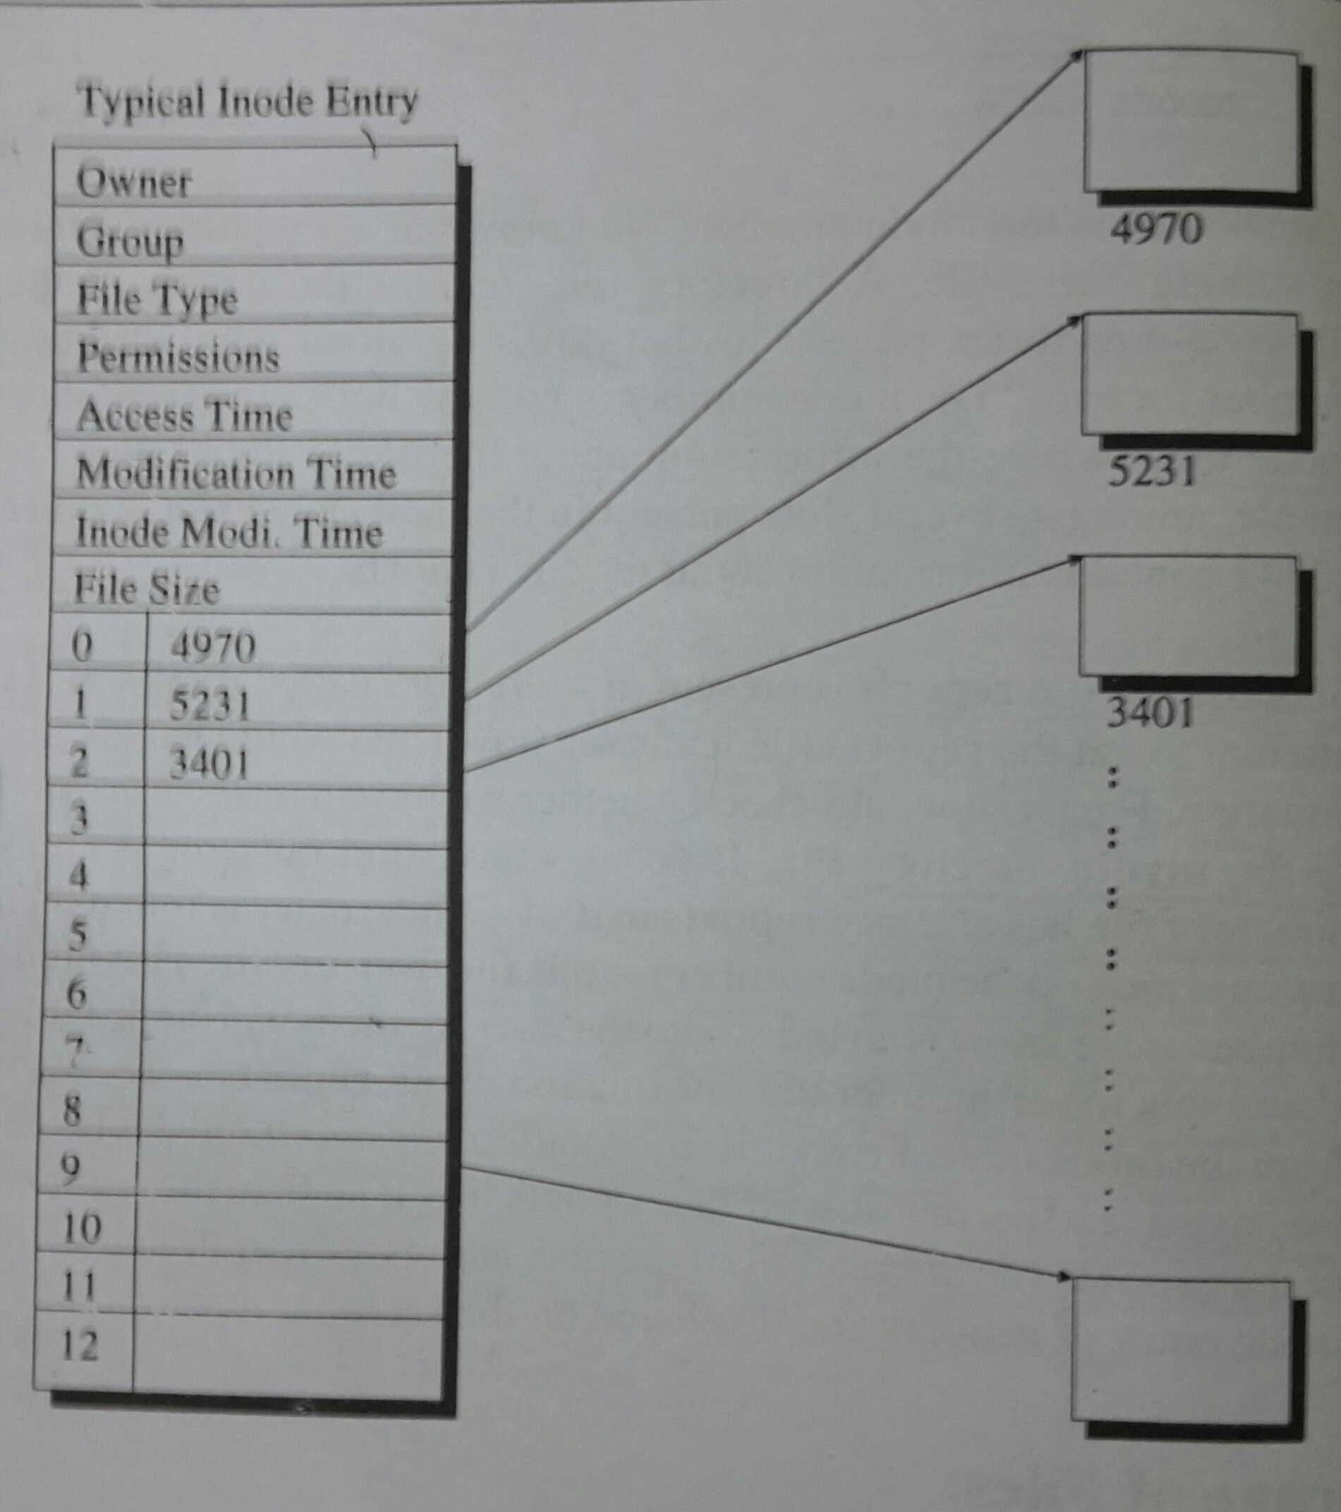
A file of size
3KB may have
its entries as

Slide 11
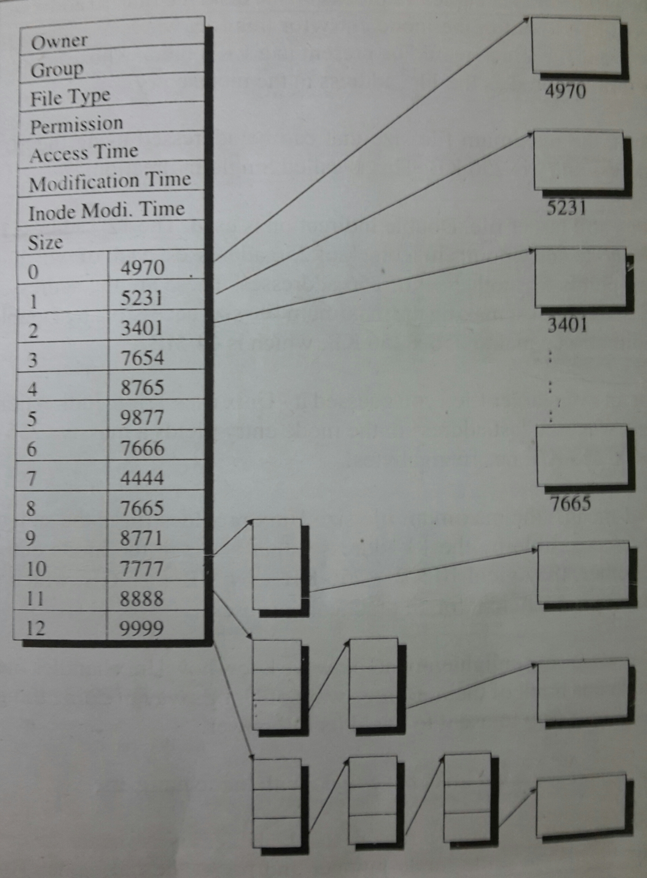
For Files larger
than 10KB

Slide 12


